Slide 1



Lesson 3
Who uses accounting information
Chapter A1 : Beginner
Lesson 1 : Why Accounting is so Easy !
Lesson 2 : What is Accounting !
Lesson 3 : Who Uses Accounting Information
Ejaj-Ur-Rahaman

Slide 2


2
Review
Lesson
Accounting is a language. It is also a process of...
3 activities: Identify > Record & Summerize > Communicate
Accounting produces & provides Key information for decision making
Keywords: Accounting is a process, identify, record, summarize, communicate, decision making
Ejaj-Ur-Rahaman

Slide 3


Brain Teaser Entry Ticket
What single word can be used to complete all the words below:
D E _ _ _ ST
C _ _ _ E R
S T _ _ _
P _ _ _ N T
i Can
The answer: is a r e
Ejaj-Ur-Rahaman

Slide 4
Who uses accounting Information ?
Any stakeholder (individual or organization) directly or indirectly influenced by the accounting data and use it for decision making then they are the users of accounting information.
Directly or indirectly influenced
Shareholder
Stakeholder
Stockholder
Owner
Ejaj-Ur-Rahaman

Slide 5
Who uses accounting Information ?
Any stakeholder (individual or organization) directly or indirectly influenced by the accounting data and use it for decision making then they are the users of accounting information.
Internal Users
External Users
Ejaj-Ur-Rahaman

Slide 6
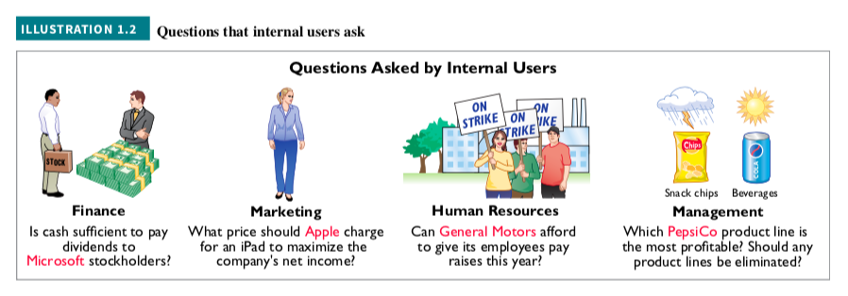
Who uses accounting Information ?
Internal Users
Ejaj-Ur-Rahaman

Slide 7
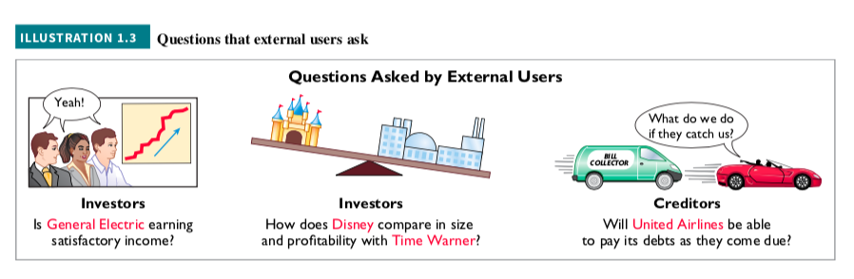
Who uses accounting Information ?
External Users
Ejaj-Ur-Rahaman

Slide 8
3
Review
Lesson
Any stakeholder uses accounting information for decision making
2 types of users: Internal & External
Internal: manager, marketing team, External: investor, creditor
Keywords: stakeholder, users, decision making
Ejaj-Ur-Rahaman

Slide 9

Quick Quiz Exit Ticket
1. To maximize the net income of company ABC, what should be the price of the product ? - who asked this type of question?
i Can
Internal
external
Ejaj-Ur-Rahaman

Slide 10
Quick Quiz Exit Ticket
True/False
2. Only investors are the users of accounting information
i Can
Ejaj-Ur-Rahaman

Slide 11
Lesson 4
Assets - Mr. Debit The Power
Chapter B2 : ALICE ! - Know her to know Accounting
Lesson 4 : Assets - Mr. Debit The Power
Lesson 5 : Liability - Ms. Credit The Burden
Lesson 6 : Income or Revenue - I am not Profit
Lesson 7 : Capital - I am from owner
Lesson 8 : Expense - Mr. Debit 2
Ejaj-Ur-Rahaman

